Slide 1

Library Management System
Presented By:
Venkatesh (24B11CS191)
Chaitanya(24B11CS027)
Rupesh (24B11CS210)
Jashuva(24B11CS105)

Slide 2
ROLES
Chaitanya – User Interface development in Apache Netbeans using swing forms.
Rupesh – Database creation in MySQL all accessing all records of library.
Venkatesh – JDBC using mysql connector in netbeans and performing all connection in running and accessing data from database.
Jashuva - Testing the complete process and preparing a detailed document .

Slide 3

Problem statement
In many organizations, library information is maintained manually using paper records or spreadsheets. This leads to:
Data redundancy
Difficulty in searching records
Time-consuming updates
Risk of data loss
Therefore, there is a need for an automated system to manage books records efficiently.

Slide 4

OBJECTIVE
The main objectives of the project are:
To store library books information in a database
To add new books
To update/ delete existing admin details.
To delete or edit existing books
To display books information in an easy-to-use interface
To add new staff
To delete/ edit existing staff details

Slide 5

Modules
Admin Management Module
This module manages admin information in the database. It allows the admin to login into his account and can access details of library books, staff . It allows admin to add new books, edit and remove existing books. It performs database operations such as insert, update, delete, and select.
2) Books Management Module
This module manages books information available in library. It stores every books by a ID. It allows user to add new books, delete and edit existing books.
3) Staff Management Module
This module manages all staff members details. I allows admin to add new staff, remove and delete existing staff details.

Slide 6
4. Search Module
This module allows the user to search for books information using Book ID or Author Name or Book Name. It retrieves the required book details from the database and displays them to the user/admin.
5 Database Connectivity Module
This module connects the Apache Netbeans application to the MySQL database using My SQL Connector. It is responsible for establishing database connection, executing SQL queries, retrieving data, and closing the connection.
6. User Interface Module
This module provides the graphical user interface (GUI) using Java Swing. It allows the user to interact with the system by entering admin details, performing operations, and viewing results.
7. Display Module
This module displays books , staff and admin information in a structured format, usually in a table. It retrieves data from the database and presents it clearly for easy understanding.

Slide 7
DATABASE
The database is designed using the Relational Database Model and implemented using MySQL Database.
Admin Table:
The Admin table stores information about admins who can access library details in the organization.
User_ID – Varchar(50)
Name – Varchar(50)
Password – Varchar(30)
Contact – Varchar(10)

Slide 8
2) Book Table:
The Book table stores information about books available in library.
Book_ID – Integer
Category – Varchar(50)
Name – Varchar(50)
Author – Varchar(50)
Copies – Integer
3 ) Staff Table:
The Staff table stores information about staff member details in library.
Staff_ID – Varchar(50)
Name – Varchar(30)
Contact – Varchar(10)

Slide 9
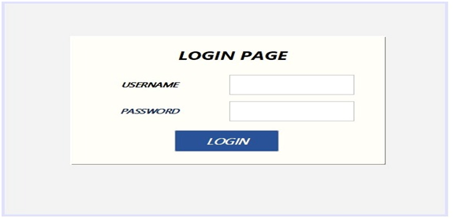
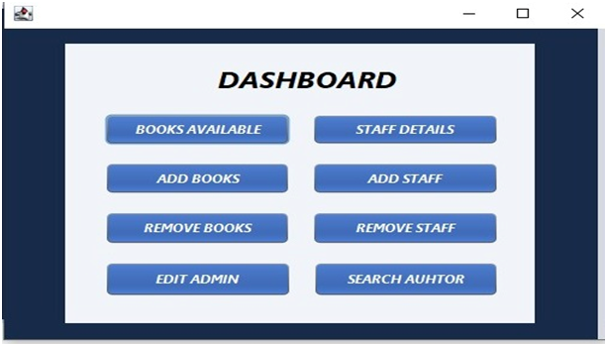
USER INTERFACE

Slide 10
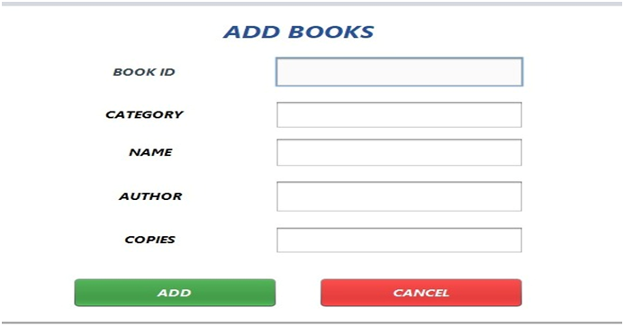
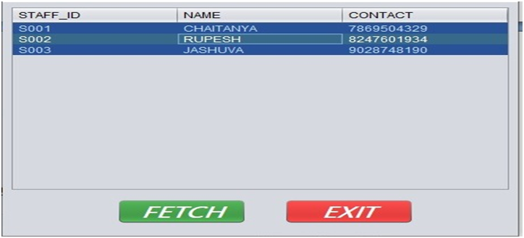
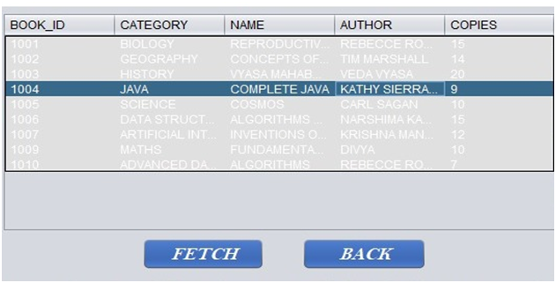
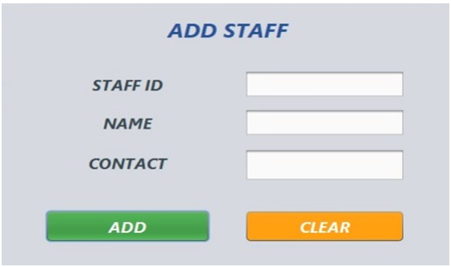

Slide 11

THANK YOU

